Slide 1
How metabolic interaction influences microbial co-occurrence
Network Science
Zhifeng Yang 12/4/2020
Department of Microbiology and Plant Biology

Slide 2
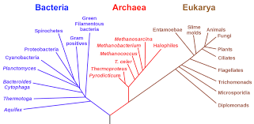
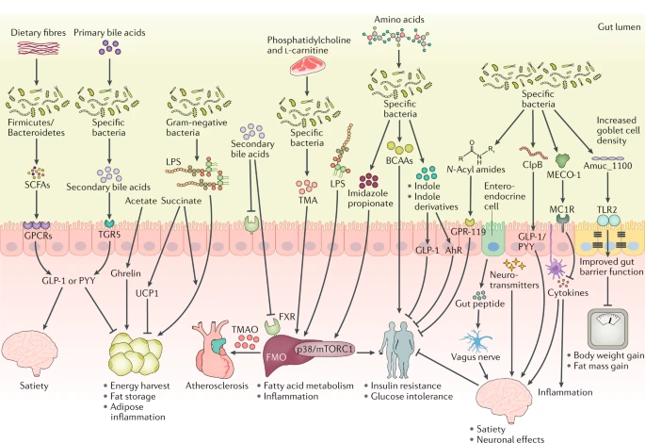
Diverse microbes coexist in earth
The longest evolution makes the most diverse group
Distributed nearly everywhere: Deep sea, ice, air, soil, body
Diverse metabolism of microbes generate complex nutrient cycle
Fan, 2020

Slide 3
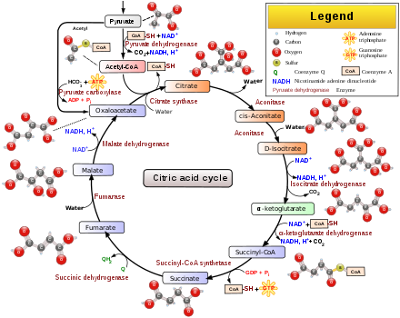
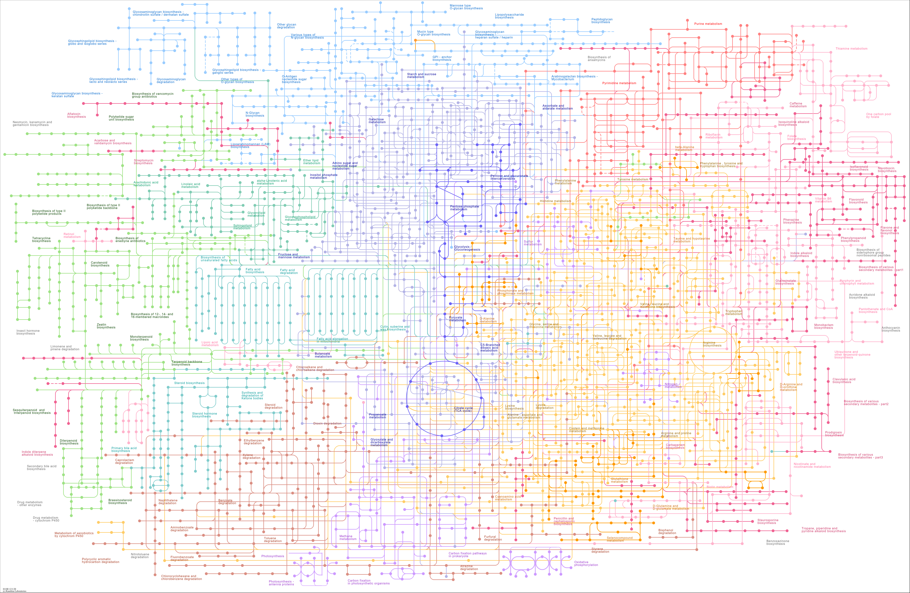
Metabolic network
TCA cycle
A whole network for all species
The metabolic network is composed hundreds of pathways.
The network covers the main trait of the species, such as the energy generation, construction of cell components

Slide 4
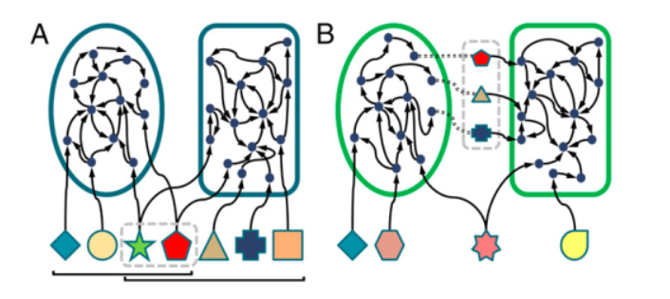
Metabolic interaction
Competition
Two metabolic network may compete for food
Complementary
Two metabolic network may provide food to each other
(Levy and Borenstein 2013).

Slide 5
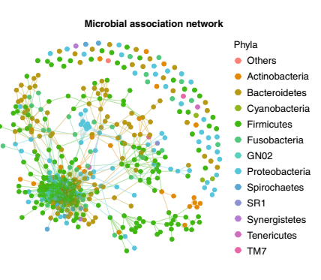
The coexistence of microbes?
The coexistence of microbes depends on a lot of factors:
Environment
Competition and mutualism
Chance
Evolution
Question:
How metabolic interaction influences microbial co-occurrence
Hypothesis:
If two species compete for food, they tend to not coexist. If they could provide food to each, they tend to coexist

Slide 6
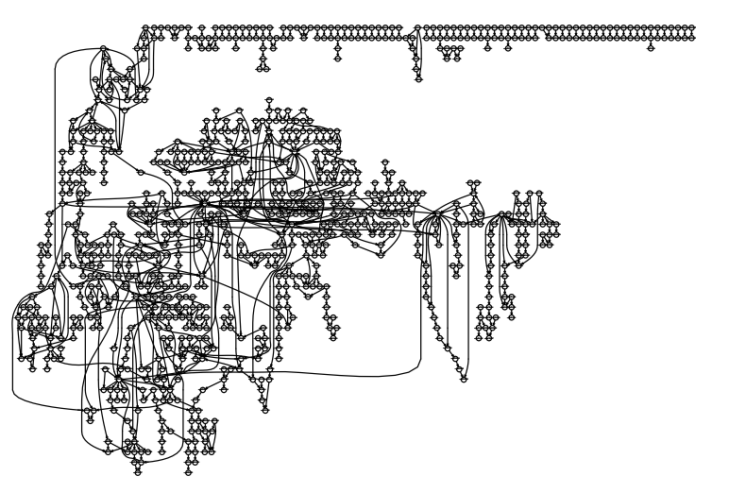
1. Collect metabolic network
KEGG: Kyoto Encyclopedia of Genes and Genomes
A network of E.coli
Nodes are compounds;
Edges are reactions.

Slide 7
2. Simplify the network
Find the strongly connected components and replace them with nodes.
After replacement, the nodes without indegree should be the food of microbes.

Slide 8
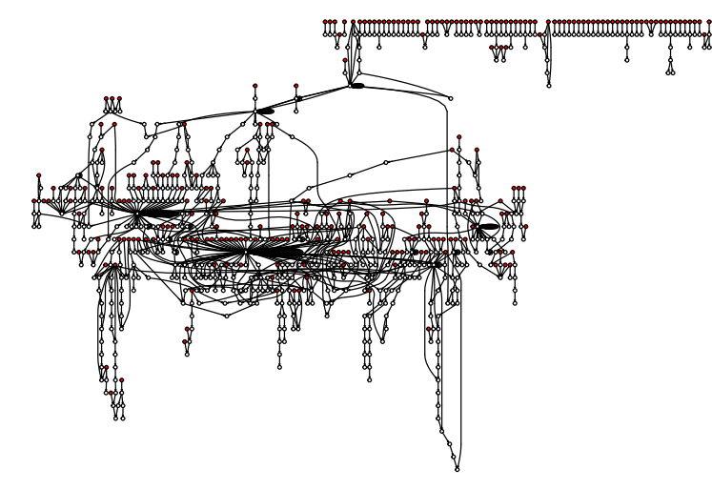
3. Determine seed set and product set for the simplified network
seed set: the nodes without indegrees
product set: the left nodes

Slide 9
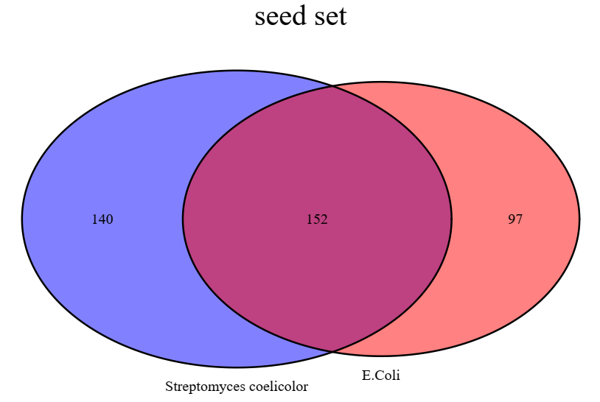
4. Metabolic competition and complementarity indexes
The competition index for Streptomyces -> E.Coli = 152/(96 + 152) = 0.6 while the index for E. coli -> Streptomycesis =140/(140 + 152) = 0.5.

Slide 10
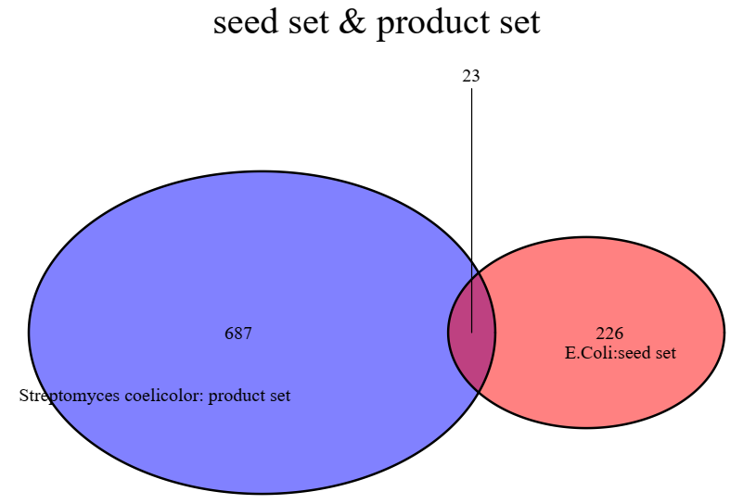
4. Metabolic competition and complementarity indexes
The complementarity index for Streptomyces -> E.Coli is 22/(22 + 227) = 0.0883534

Slide 11
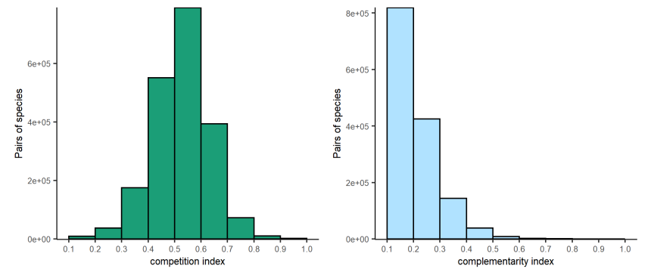
5. Calculate the two indexes for all microbes in KEGG
1429 species are used to calculate the two indexes by pair.

Slide 12
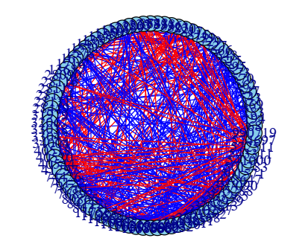
6. The coexistence microbial network at human gut
Include both positive (red) and negative(blue) correlation
Red: coexistence
Blue: exclude each other

Slide 13
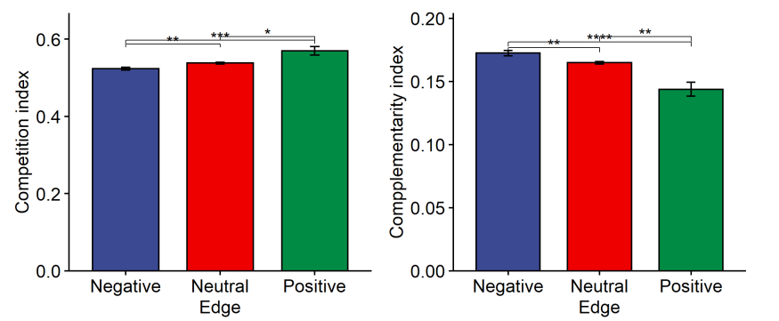
Final: test whether metabolic interaction influences coexistence
The result is against my hypothesis.
If two species compete for food (higher competition index), they tend to coexist.
If they could provide food to each (higher complementarity index), they tend to not coexist

Slide 14
Conclusion
Metabolic interaction could influence coexistence.
Species competing for food tend to live together in human gut.
Limitation:
The question need to be tested in more environments.
The nodes should be attributed weight for their importance in network.

